Slide 1
WINE QUALITY PREDICTION
BY:
18311A12D9
18311A12D3
18311A12D2

Slide 2
ABSTRACT
In recent years, most of the industries are promoting their products based on the quality certification they received on the products. The traditional way of assessing the product quality is time consuming, however with the invent of machine learning techniques the processes has become more efficient and consumed less time than before. Our project explores the usage of machine learning techniques such as linear regression, neural network and support vector machine for product quality in two ways. Firstly, determine the dependency of target variable on independent variables and secondly, predicting the value of target variable. On the basis of computed dependency, important variables are selected those make significant impact on dependent variable. Further, neural network and support vector machine are used to predict the values of dependent variable. All the experiments are performed on Red Wine and White Wine datasets.

Slide 3
INTRODUCTION
The quality of the wine is a very important part for the consumers as well as the manufacturing industries. Industries are increasing their sales using product quality certification. Nowadays, all over the world wine is a regularly used beverage and the industries are using the certification of product quality to increases their value in the market.
Previously, testing of product quality will be done at the end of the production, this is time taking process and it requires a lot of resources such as the need for various human experts for the assessment of product quality which makes this process very expensive.
Here we will deal with both the white and red wine type quality, we use classification techniques to check further the quality of the wine i.e. is it good or bad.

Slide 4
HARDWARE AND SOFTWARE REQUIREMENTS
SOFTWARE REQUIREMENTS:
Operating system: Windows7 and above.
Technology: Anaconda navigator(jupyter notebook)
Software libraries: Pandas, Seaborn, Numpy, Matplotlib,
Scikit-learn.
HARDWARE REQUIREMENTS :
Processor: INTEL i3 7th gen or higher
RAM: 4GB or above
Hard disk: 10GB

Slide 5
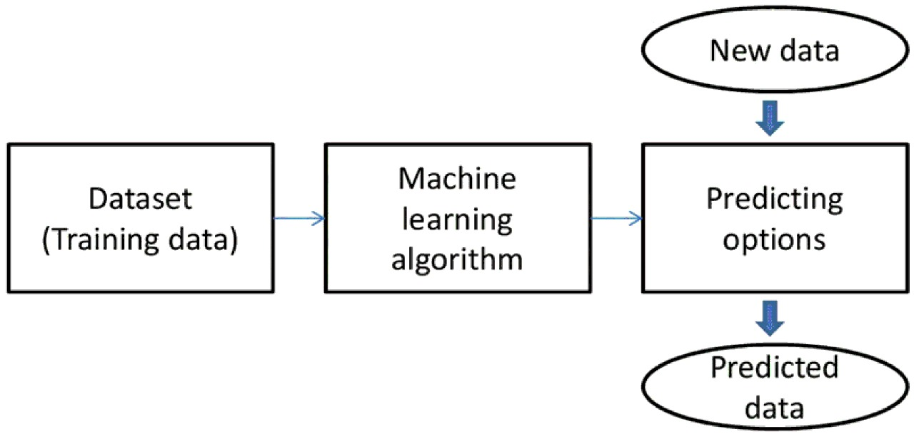
SYSTEM DESIGN

Slide 6
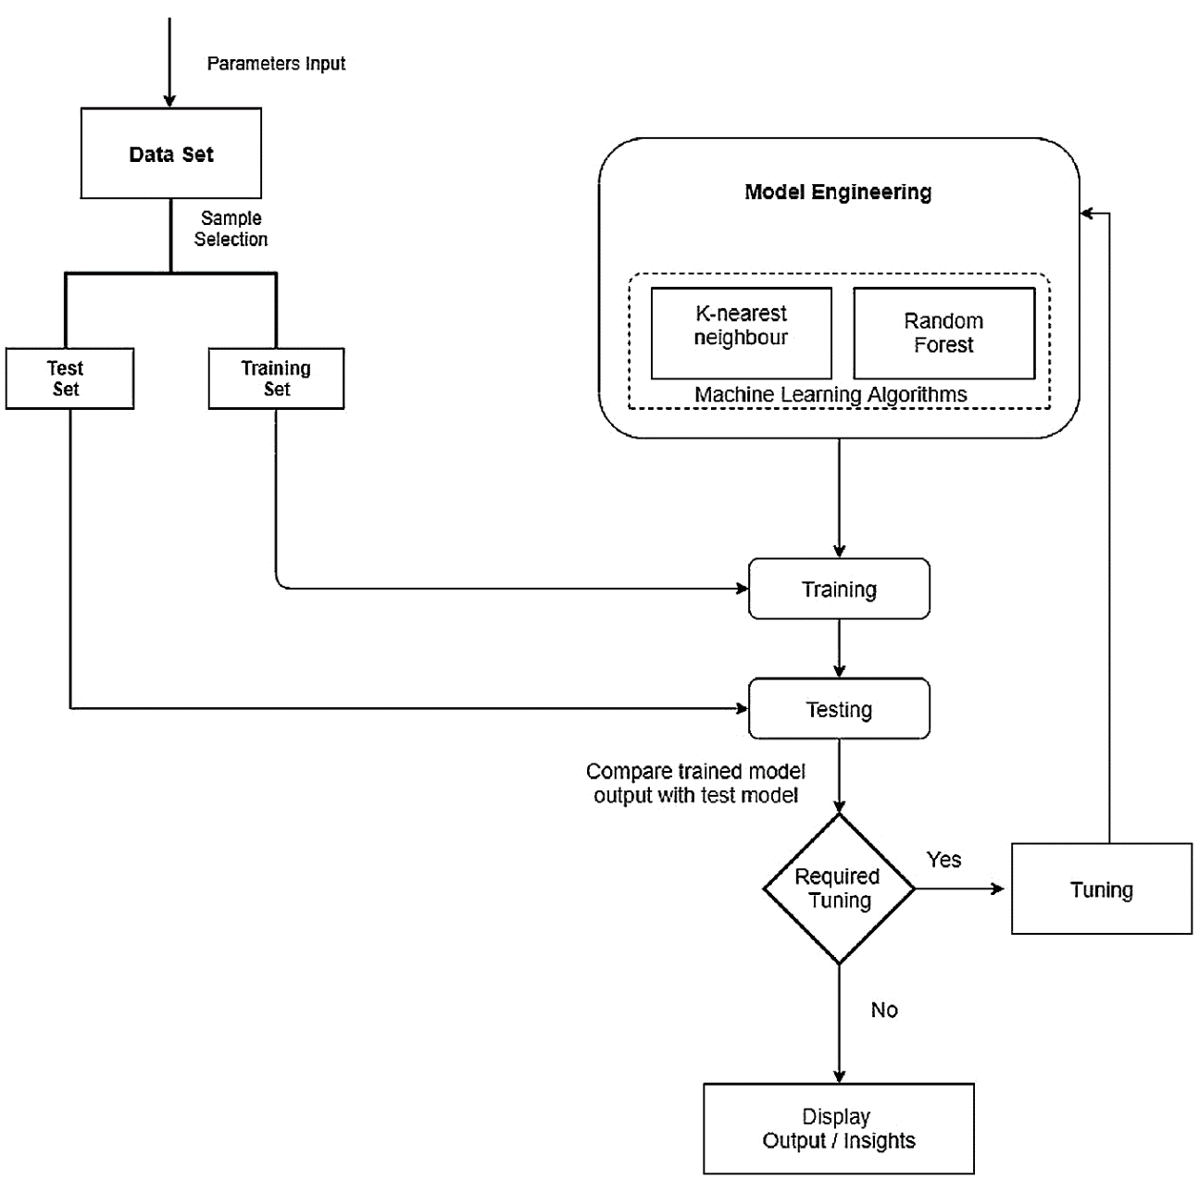

Slide 7
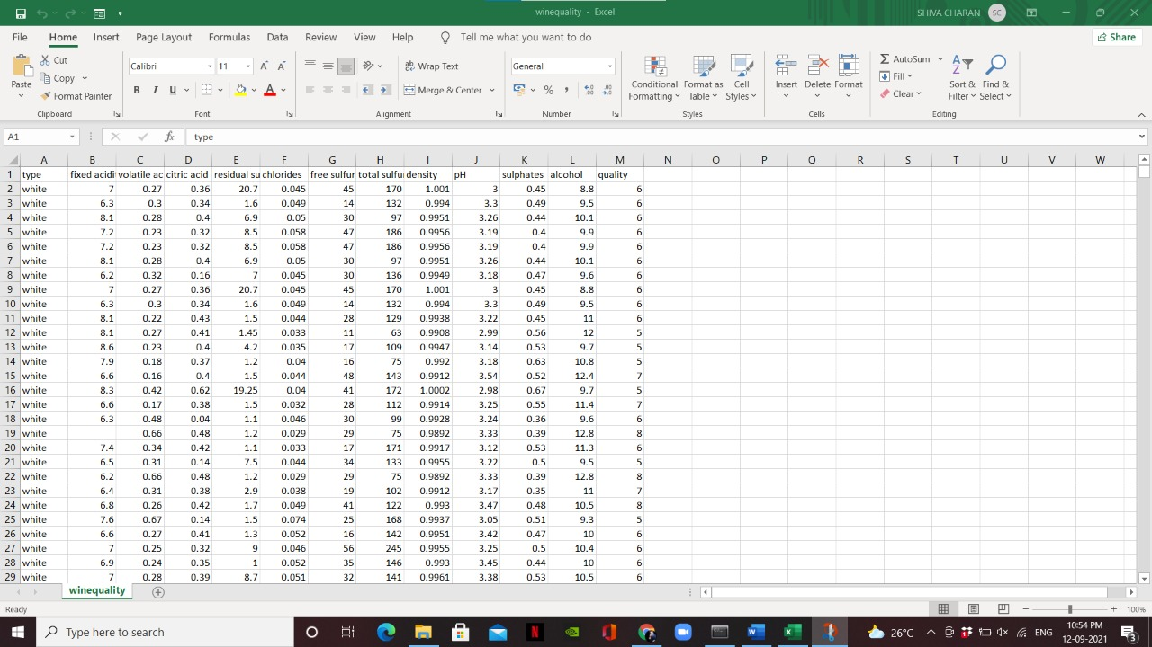
DATASET:

Slide 8
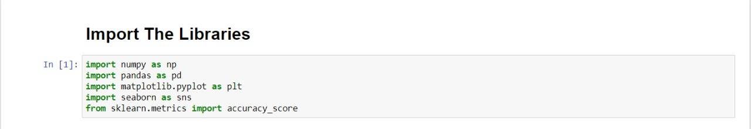
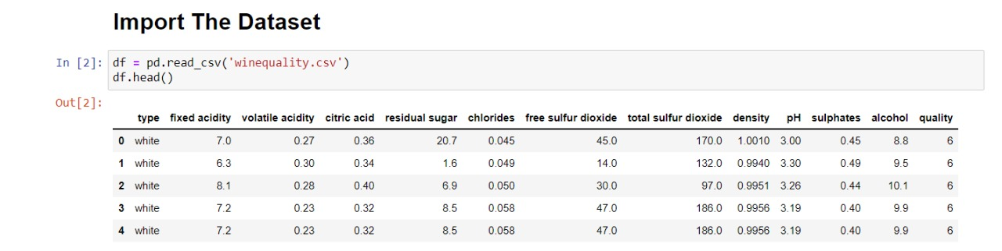
IMPLEMENTATION SCREENSHOTS: IMPORTING LIBRARIES: IMPORTING DATASET:

Slide 9
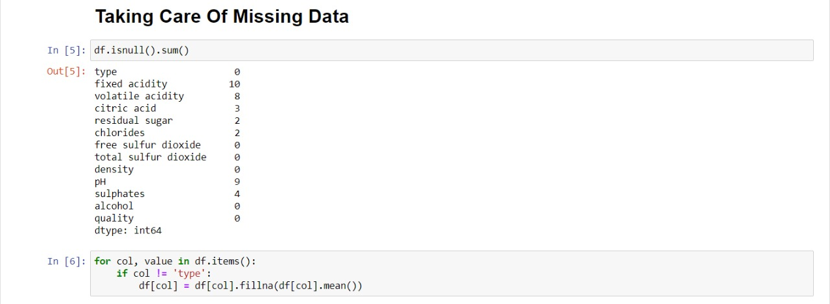
HANDLING MISSING VALUES:

Slide 10
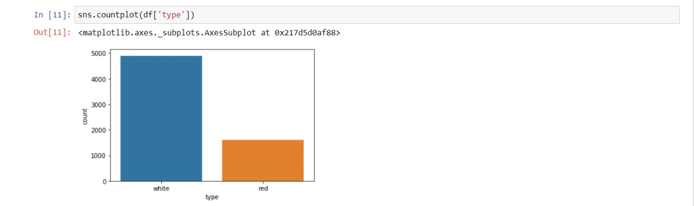
WHITE AND RED WINE RECORDS COUNT:

Slide 11
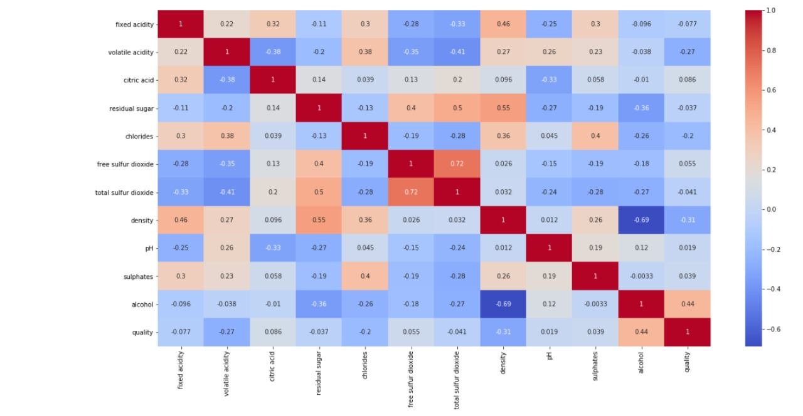
CORRELATION MATRIX:

Slide 12
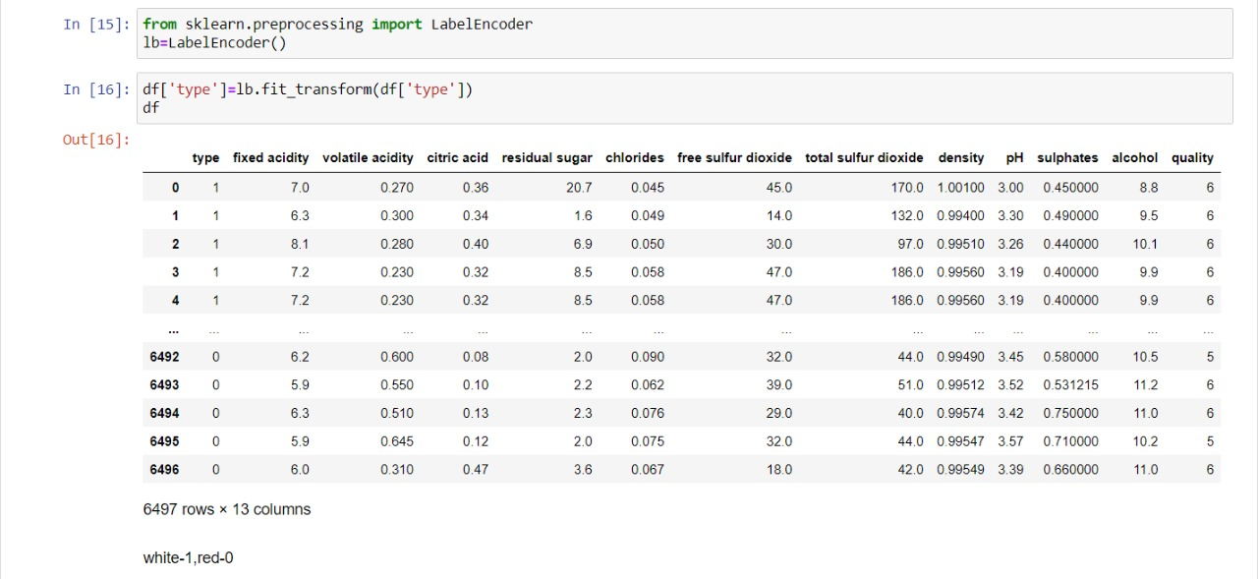
LABEL ENCODING:

Slide 13
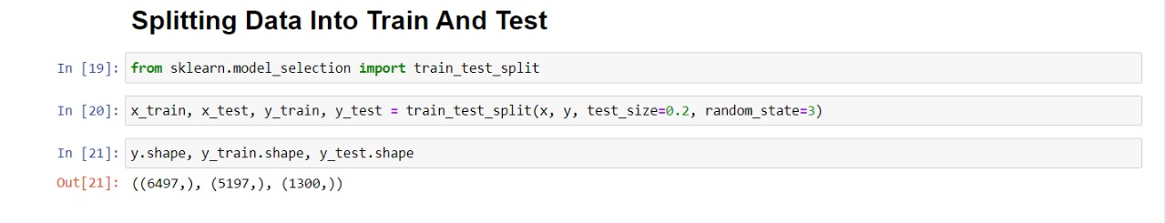
SPLITTING DATA INTO TRAIN AND TEST:

Slide 14
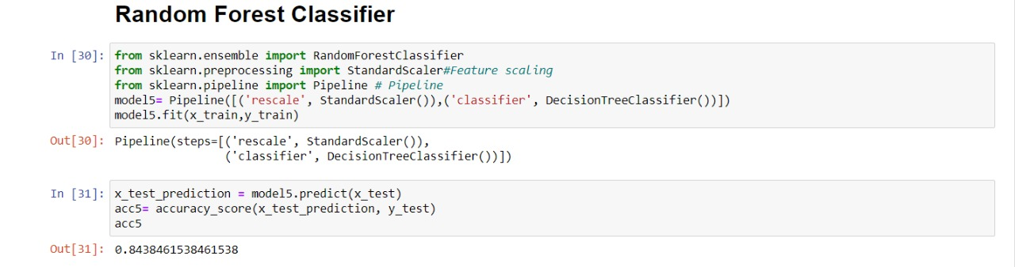
RANDOM FOREST:
“Random Forest is a classifier that contains a number of decision trees on various subsets of the given dataset and takes the average to improve the predictive accuracy of that dataset.” Instead of relying on one decision tree, the random forest takes the prediction from each tree and based on the majority votes of predictions, and it predicts the final output.
The greater number of trees in the forest leads to higher accuracy and prevents the problem of overfitting.

Slide 15
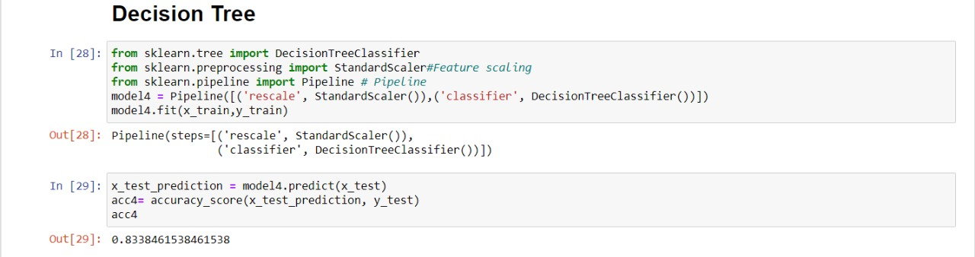
DECISION TREE:
Decision Tree is a Supervised learning technique that can be used for both classification and Regression problems, but mostly it is preferred for solving Classification problems. It is a tree-structured classifier, where internal nodes represent the features of a dataset, branches represent the decision rules and each leaf node represents the outcome.
In a Decision tree, there are two nodes, which are the Decision Node and Leaf Node. Decision nodes are used to make any decision and have multiple branches, whereas Leaf nodes are the output of those decisions and do not contain any further branches.
The decisions or the test are performed on the basis of features of the given dataset.

Slide 16
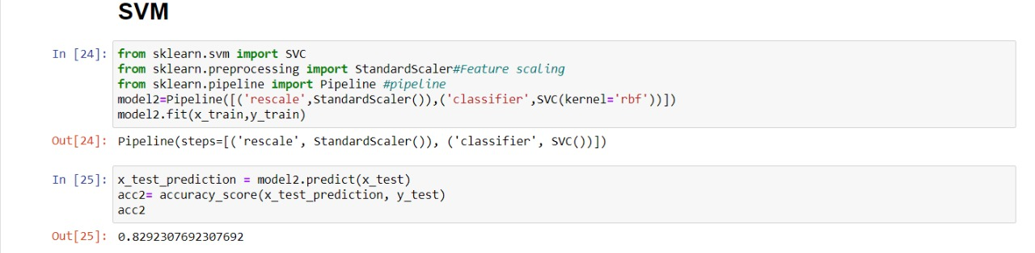
SVM:
The support vector machine (SVM) is the most popular and mostwidely used machine learning algorithm. It is a supervised learningwidely used machine learning algorithm. It is a supervised learning
model that can perform classification and regression tasks. However,
it is primarily used for classification problems in machine learning.

Slide 17
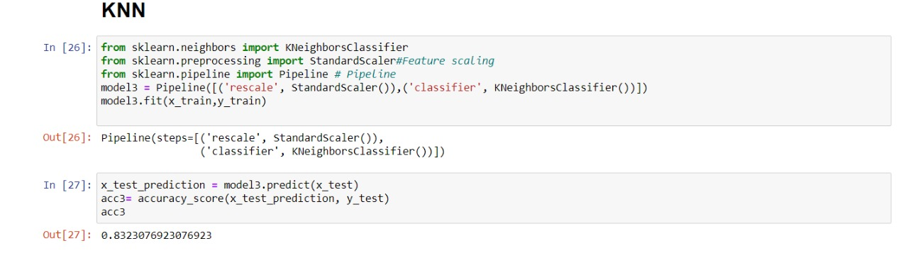
KNN:
K-Nearest Neighbour is one of the simplest Machine Learning algorithms based on Supervised Learning technique.
K-NN algorithm assumes the similarity between the new case/data and available cases and put the new case into the category that is most similar to the available categories.
K-NN algorithm stores all the available data and classifies a new data point based on the similarity. This means when new data appears then it can be easily classified into a well suite category by using K- NN algorithm.

Slide 18
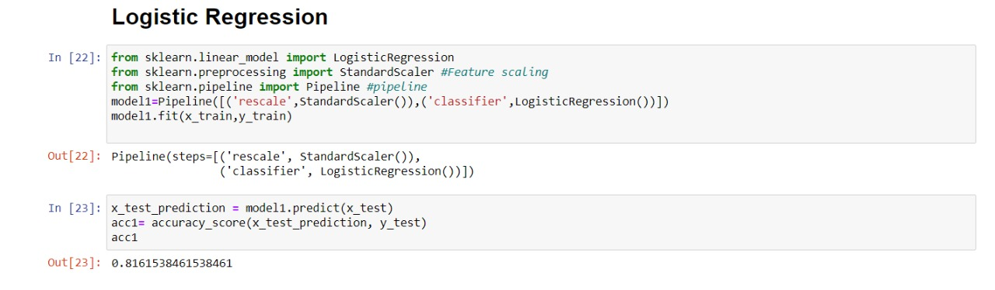
LOGISTIC REGRESSION:
Logistic regression is a supervised learning classification algorithm used to predict the probability of a target variable. The nature of target or dependent variable is dichotomous, which means there would be only two possible classes.
In simple words, the dependent variable is binary in nature having data coded as either 1 (stands for success/yes) or 0 (stands for failure/no).

Slide 19
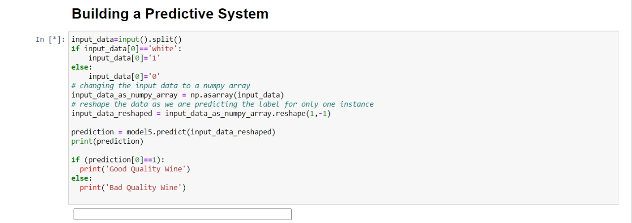
OUTPUT SCREENSHOTS:
From the above results produced by all the mentioned machine learning algorithms we choose the algorithm that has the most accuracy in order to classify the wine into a good or bad quality wine. Random forest produces most accuracy, continued by decision tree.

Slide 20
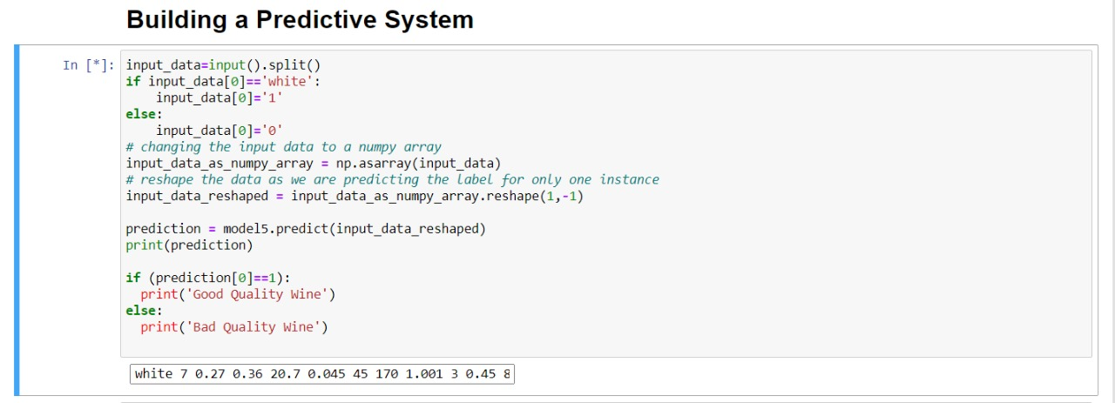

Slide 21
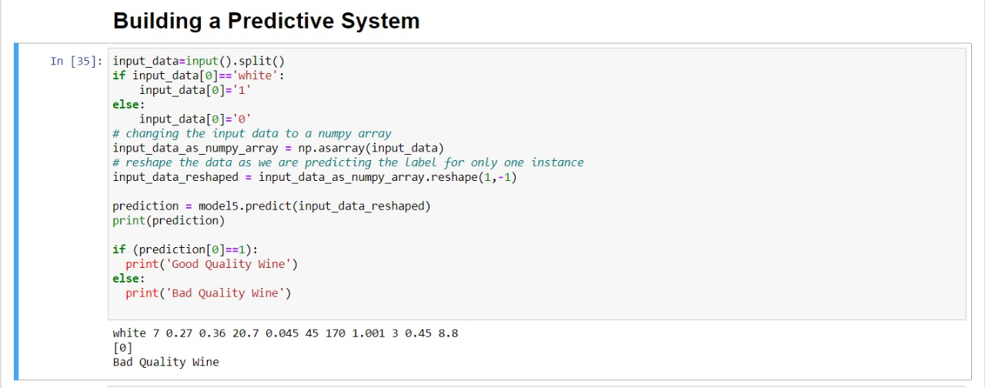

Slide 22
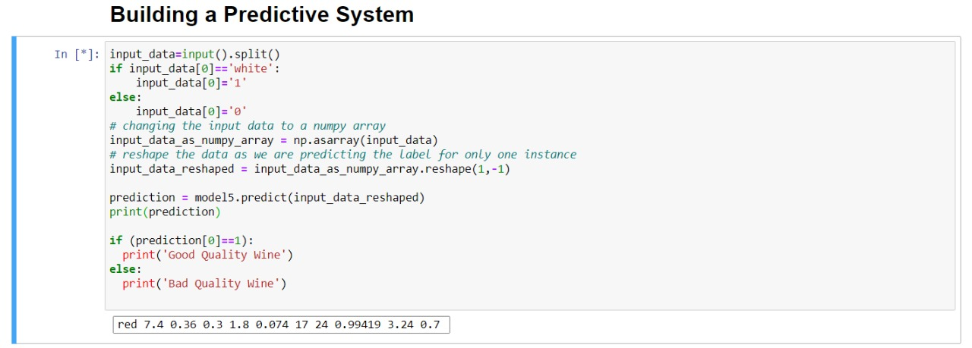

Slide 23
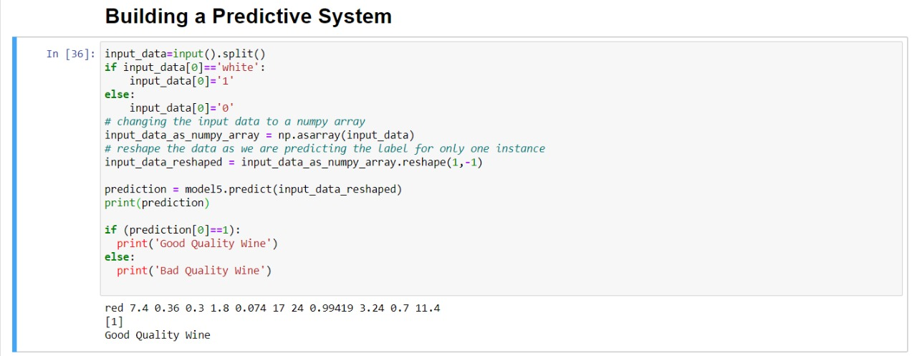

Slide 24
CONCLUSION
This project mentioned about predicting the quality of Wine using various machine learning techniques. The feature select on algorithm provided a clear idea about theimportance of the attributes for prediction of quality, which was time consuming and expensive when done in the traditional way. We have also compared the accuracy ofeach technique used in prediction of quality and it was found that these classifiers performed well. We have found that the Random Forest based feature sets performed better than others. We have also found that the Random Forest classifier performed better compared to all other classifiers for wine data set.
In future we can try other performance measures and other machine learning techniques for better comparison on results. This analysis will help the industries to predict the quality of the different type of wines based on certain attributes and also it will helpful for them to make good product in the future.

Slide 25


